Slide 1
CAN BUS PROTOTYPE
College Name :
Government College Of Engineering , Karad .
Mini Project Name :
Team Mentor Name :
Prof. A.S.Shinde
Team Members :
Ashish Prabhakar Shinde (21151206)
Suyog Jayavant Kale (21151225)
Rahul Narendra Wankhade (21151261)

Slide 2
Index :
Introduction
CAN BUS most attractive features
OVERVIEW
CAN Signal (Differential Signal)
Controller Area Network Block Diagram
Working
Applications
Connection of CAN BUS Module
MCP2515 Arduino Circuit Diagram
Conclusion

Slide 3
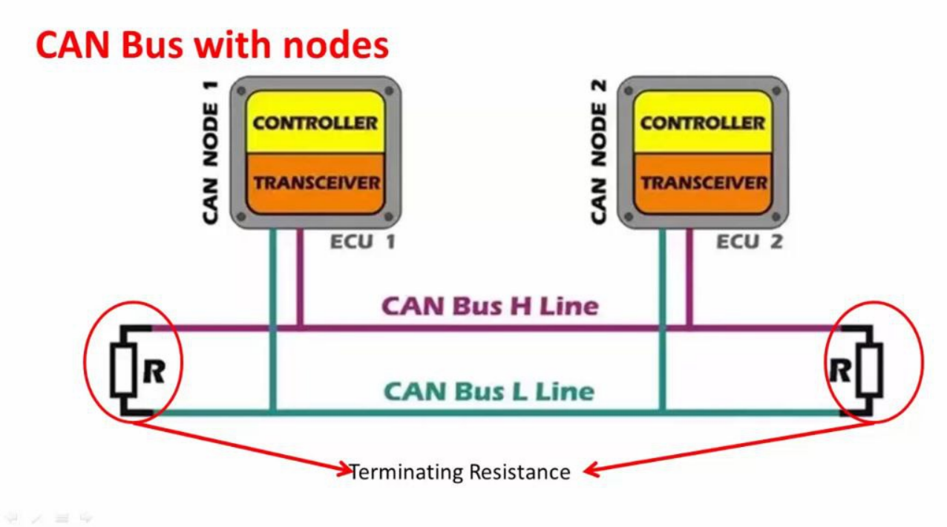
Introduction :
It is a multi-master serial communication bus whose basic design specification called for high speed, high noise- immunity and error-detection features
CAN offers data communication up to 1 Mbit/sec
The Error Confinement and the Error Detection features make it more reliable in noise-critical environments. In the automotive industries
Extensive Use: CAN is widely used in automotive applications for tasks like engine control, transmission control, and in-vehicle networking. It's also used in industrial automation, aerospace, and various other fields

Slide 4
CAN BUS most attractive features :
Low cost
Extreme robustness
High data transmission speeds (up to 1 MB/sec).
Reliability. Excellent error handling and Error Confinement abilities.
Automatic re-transmission of faulty messages.
Automatic bus disconnection of nodes that are suspected to be physically faulty.
Functional addressing - data messages do not contain source or destination addresses, only identifiers relating to their function and/or priority.
Message Prioritization: CAN messages are prioritized based on their identifier values. Lower identifier values indicate higher message priority.
Arbitration: When multiple nodes attempt to transmit a message simultaneously, the CAN protocol uses a bit-wise arbitration mechanism to determine which message gets priority. Messages with lower identifier values have higher priority

Slide 5
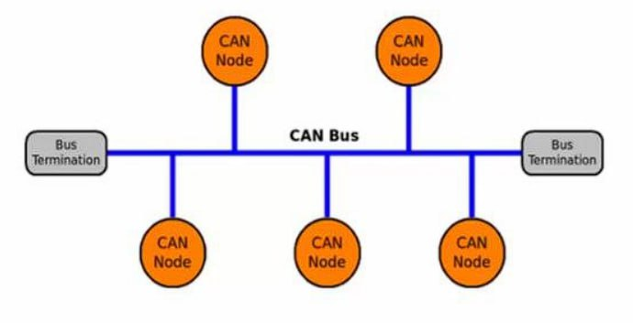
OVERVIEW :
It's a broadcast type of Bus
No way to send a data specifically to a node by its address or something.
All devices can hear the transmission
All nodes will pick up the traffic on the bus
The CAN standard defines a communication network that links all the nodes connected to a bus and enables them to talk with one another. There may or may not be a central control node, and nodes may be added at any time, even while the network is operating (hot-plugging).

Slide 6
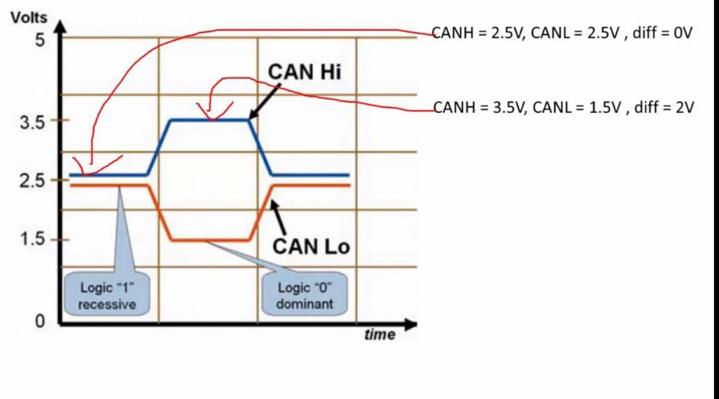
CAN Signal (Differential Signal):
Working of this project is very simple as all the work is done by the libraries (SPI and CAN). Since CAN is message-based communication, you need to send a message anywhere between 0 and 8 bytes.
In this project, the transmitter is sending a message as 1 1 2 3 0 5 6 7. This message is transmitted over CAN Bus and the receiver receives this message and is displayed on its serial monitor.
When you try to send logic “1", the CAN bus state will be recessive. Recessive state is a place on the CAN bus where potential difference between CANH and CANL is ‘0V’
When you try to send logic "0", the CAN bus state will be dominant.Dominant state is a place on the CAN bus where potential difference between CANH and CANL is -2V

Slide 7
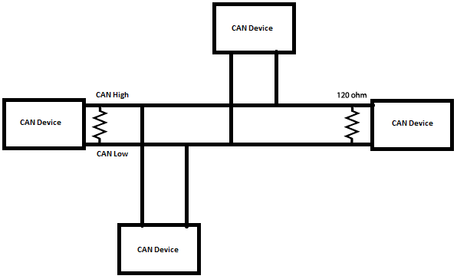
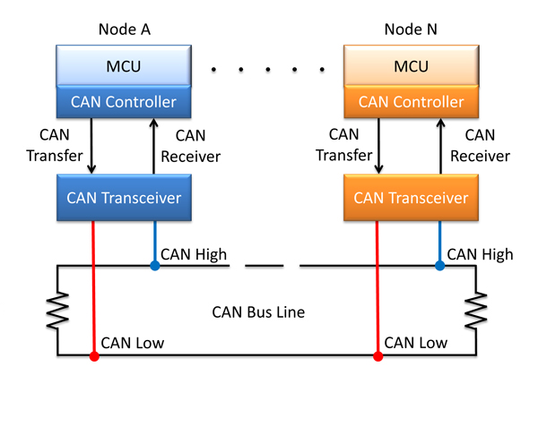
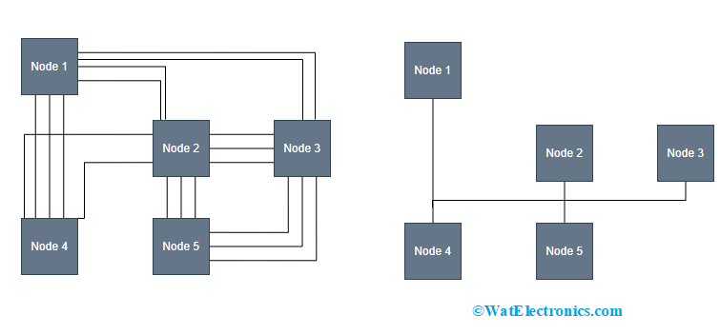
Controller Area Network Block Diagram :
Basic Node Diagram
Basic Block Diagram Of CAN BUS

Slide 8
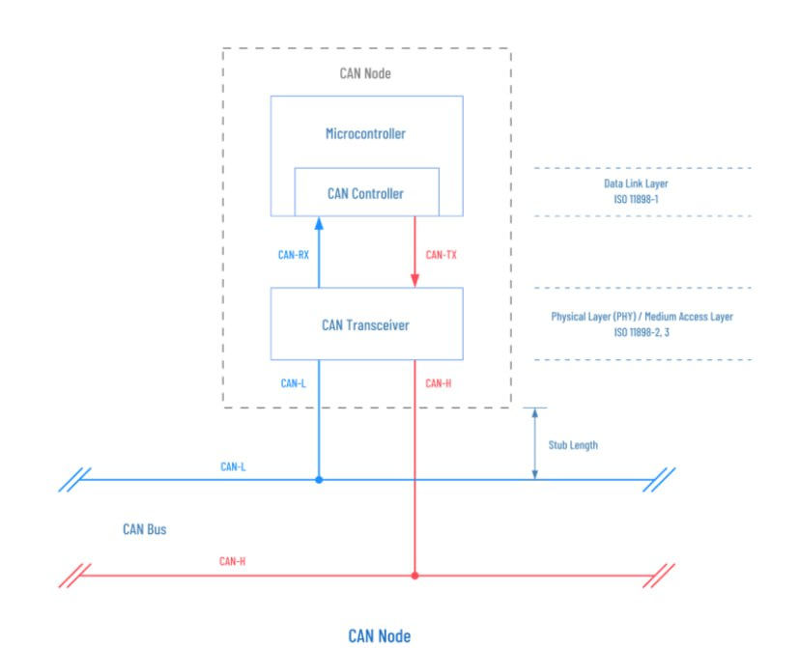
Working :
Hardware Components:
CAN Transceivers: These components convert the logic-level signals from the microcontrollers into the differential signals used on the CAN bus.
Microcontrollers: These are the devices responsible for sending and receiving messages on the CAN bus. They control the data to be transmitted and handle incoming data.
CAN Bus: The physical bus consists of two wires, CAN High (CANH) and CAN Low (CANL), which are used to transmit and receive data.
Power Supply: A stable power source is needed to power the microcontrollers and other electronic components on the prototype.
Message Generation
Message Transmission
Message Reception
Error Handling

Slide 9
Applications :
The CAN bus is a robust and widely used communication protocol designed for reliable data transmission in real-time environments.
Automotive Systems:
Engine control units (ECUs): CAN bus is commonly used for communication between various ECUs in a vehicle, such as the engine control unit, transmission control unit, and more.
Infotainment systems: Prototype connectivity between multimedia systems, GPS, and other in-car entertainment components.
Advanced driver assistance systems (ADAS): Implement communication between sensors, cameras, and control units for features like adaptive cruise control and lane-keeping assistance.
Industrial Automation:
Factory automation: Use CAN bus for communication between programmable logic controllers (PLCs), sensors, actuators, and other industrial devices in manufacturing environments.
Marine and Aerospace:
Marine applications , Aerospace systems.
Agricultural Machinery , Medical Devices , Research and Development

Slide 10
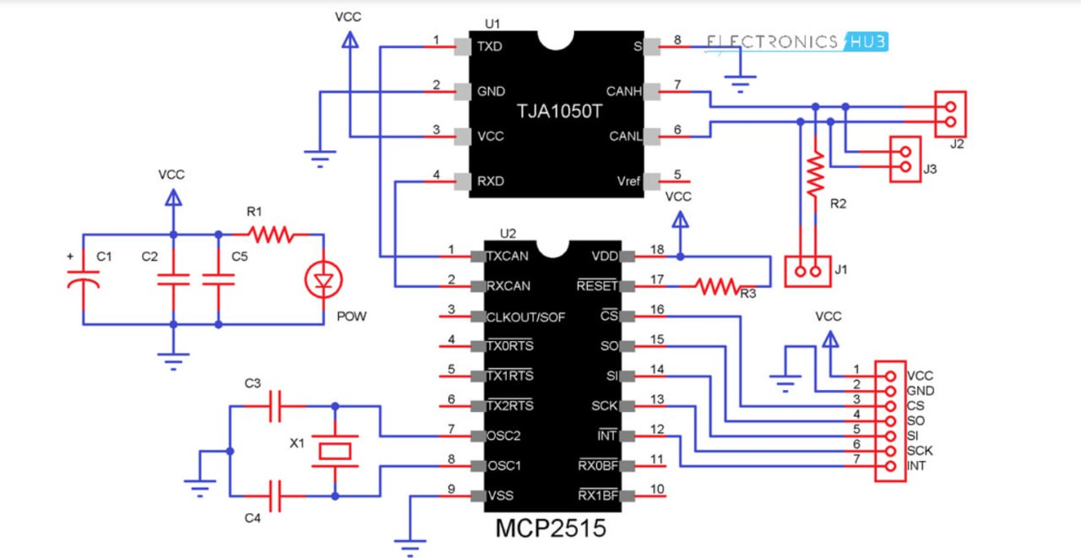
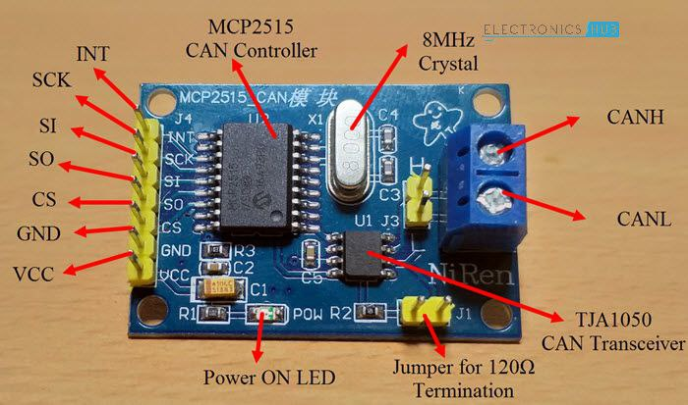
Connection of CAN Bus module :
CAN Transceiver Module

Slide 11
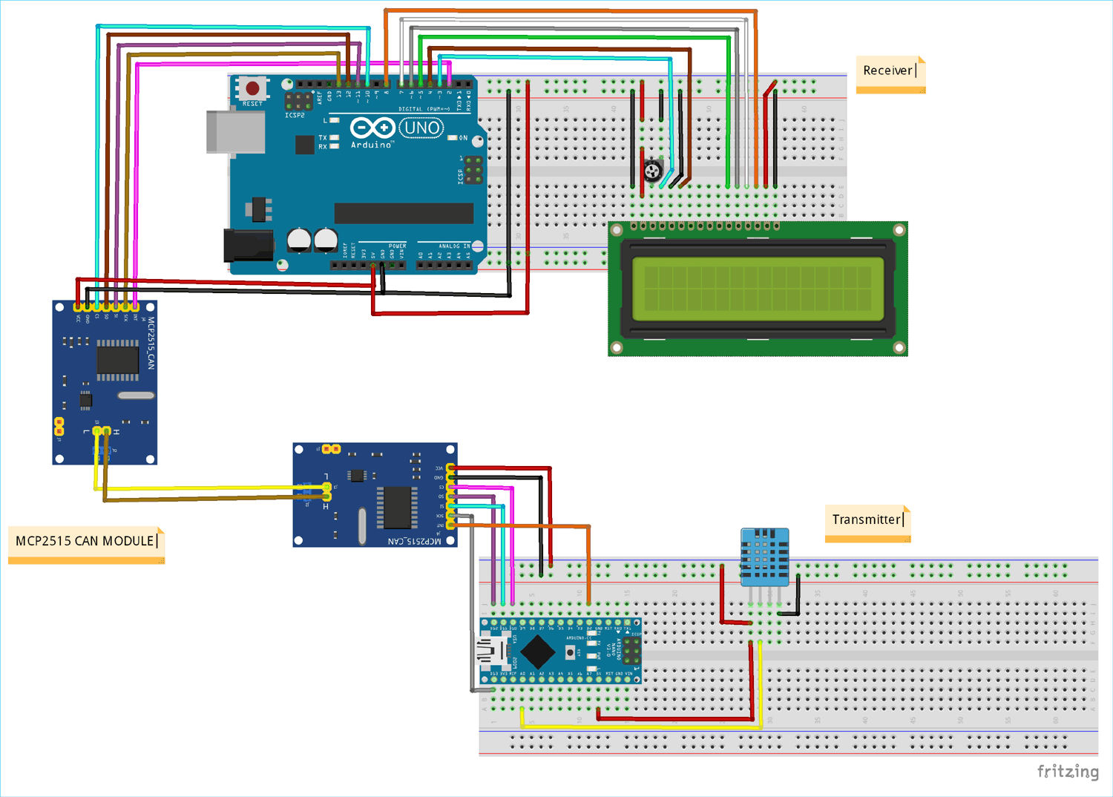
MCP2515 Arduino Circuit Diagram :

Slide 12
Conclusion :
In conclusion, a Controller Area Network (CAN) bus prototype is a valuable tool with a wide range of applications across various industries. It provides a reliable and robust means of real-time communication between electronic components and devices, making it ideal for automotive, industrial, and even home automation systems. Whether you're developing cutting-edge automotive features, optimizing industrial processes, or creating smart home solutions, a CAN bus prototype allows you to design, test, and refine your communication systems effectively.
The versatility of CAN bus technology is a key advantage, as it can be adapted to suit the specific needs of your project. From engine control units in vehicles to factory automation in manufacturing plants, the potential applications are vast.
In a rapidly evolving technological landscape, CAN bus prototypes play a crucial role in shaping the future of automotive, industrial, and automation systems, ensuring they operate efficiently, reliably, and securely.

Slide 13
Thank You !!!

